Slide 1


Madanapalle Institute of Technology & Science, Madanapalle UGC-AUTONOMOUS INSTITUTION Affiliated to JNTUA, Ananthapuramu & Approved by AICTE, New Delhi
M I T S
Department of Computer Science and Technology
Review: 0th
An Interpretable Multimodal Framework for Concise and Adaptive Primary Education
Presenting by:
Roll No. 22691A2828 Name – R Balaji

Slide 2
OBJECTIVE
To develop a low-complexity AI model that generates concise, age-appropriate educational content for students in grades 1-5.
To implement an interpretable feedback system that uses visual cues (like red highlights) to explain linguistic and conceptual errors in real-time.
To integrate Retrieval-Augmented Generation (RAG) that fetches external web knowledge and simplifies it into primary-level summaries.

Slide 3
ABSTRACT
Content Focus:
This project introduces an Adaptive Educational AI Agent engineered specifically for the cognitive needs of young learners.
Unlike standard "Black Box" models, this system prioritizes interpretability and concise outputs to prevent information overload.
The system uses Natural Language Processing (NLP) for voice-based interaction and Generative AI to create simplified visual aids for abstract subjects like Physics and Math.
The outcome is a transparent pedagogical partner that bridges the gap between complex digital information and child-level comprehension.

Slide 4
EXISTING SYSTEM
Standard LLMs (ChatGPT/Gemini): Often generate verbose, overly technical, and non-age-appropriate responses.
Text-Only Chatbots: Lack multimodal capabilities like real-time image generation or interactive visual feedback.
Opaque Logic: Most existing systems provide answers without an interpretable "why" behind the correction or explanation.

Slide 5
DISADVANTAGES
Cognitive Overload: Verbose content confuses young children who require focused, concise information.
Lack of Transparency: "Black Box" nature makes it difficult for students and teachers to understand the AI's reasoning.
Inflexible Complexity: Difficulty in automatically scaling vocabulary down to a 1st-grade level (e.g., using "branch" vs. "florescence").

Slide 6
PROPOSED SYSTEM
Lexical Constraint Layer: A hard-coded filter that forces the AI to use simplified, grade-level vocabulary.
Interpretable UI: A user-friendly interface that uses Visual Explanations and color-coded feedback for grammar and logic.
Concise RAG Pipeline: An external knowledge retrieval system that automatically summarizes web data into 1-2 simple sentences for children.
Multimodal Visualization: Generates real-time, friendly animations or images to explain complex topics on-the-fly.

Slide 7
ADVANTAGES
Enhanced Interpretability: Students learn the "why" through visual cues, not just the "what."
Reduced Complexity: Minimalist content generation ensures students stay focused and motivated.
Personalized Scaffolding: Automatically adapts its teaching style based on the specific grade level of the user.

Slide 8
RESEARCH GAP
Absence of a single platform that combines low-complexity content generation with interpretable visual feedback specifically for K-5 users.
Current educational tools use static content rather than dynamic, simplified RAG for real-world curiosity questions.

Slide 9
TENTATIVE METHODOLOGY
User Interface | React Native | Cross-platform interactive UI for voice/text and red-highlight feedback.
Orchestration | Python Logic | Manages the "Simplification Layer" and "Grade-Level Filter."
Foundation Model | AWS Bedrock (Titan/Claude) | Core engine for concise natural language and RAG handling.
Data Memory | Amazon DynamoDB | Stores student progress and simplified knowledge summaries.
Lexical Constraint Method (Vocabulary Control)
Sentence Length Restriction Method
Concise Retrieval-Augmented Generation (RAG) Method

Slide 10
EXPECTED OUTCOMES / OUTPUT
A functional prototype of a Low-Complexity Pedagogical AI Agent.
A verified Simplification Pipeline that successfully converts complex technical terms into child-friendly language.
A Responsive UI featuring real-time visual correction and multimodal concept visualization.
The system reduces ChatGPT complexity using vocabulary control, sentence restriction, analogy-based explanations, concise RAG, interpretable feedback, and multimodal visual support.

Slide 11
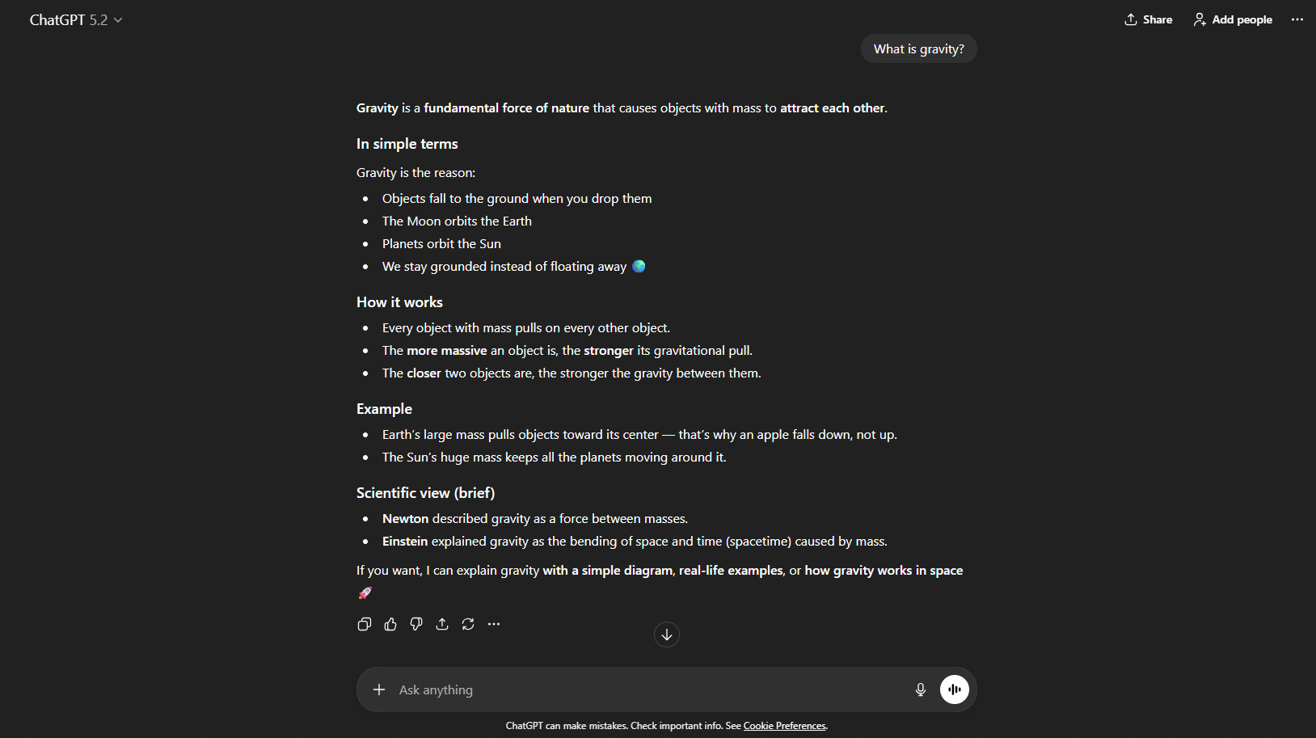
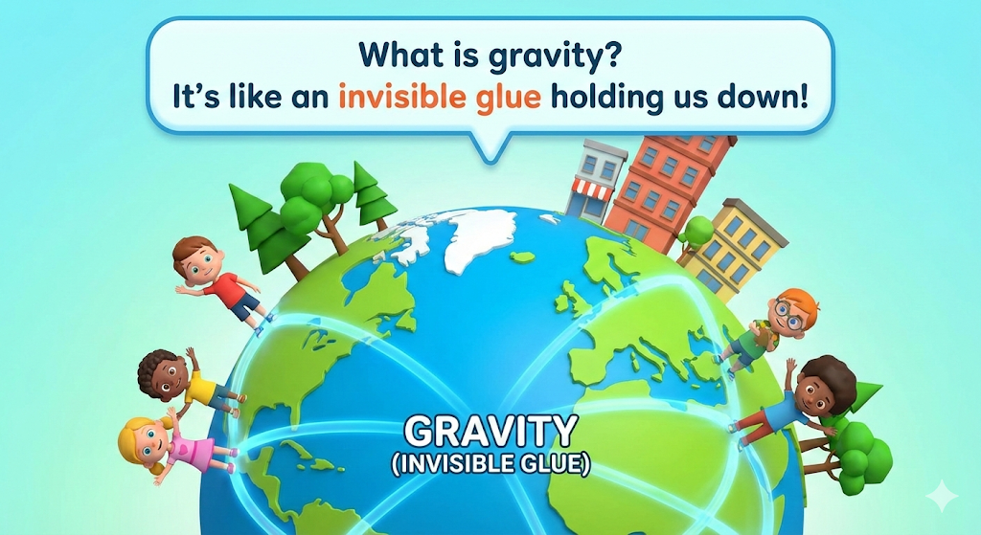
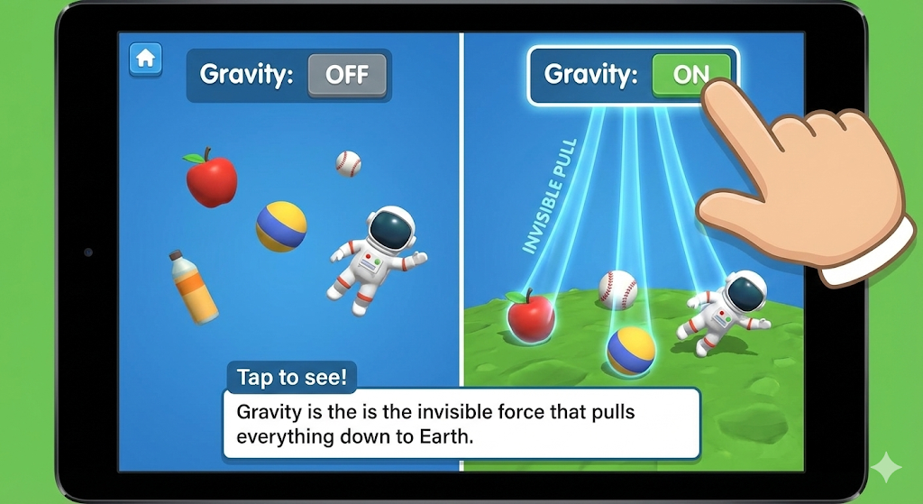
Prompt: "What is gravity?"
AI Output: "Gravity is like an invisible glue. It pulls everything toward the ground so we don't float away into space! The Earth is very big, so it has a very strong pull.“
Small images or a YouTube video
The Difference: It uses analogies (glue) and simple verbs (pulls, floats). It stays under 30 words (Concise).

Slide 12
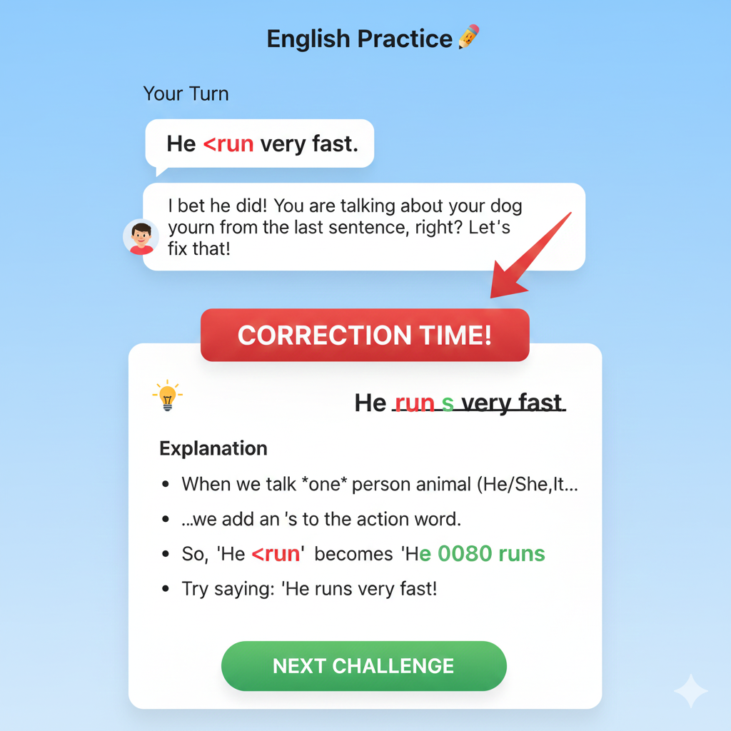
Student: "Yesterday, I go to the park with my dog."
Your AI Response: * Text: "That sounds like a fun day! But since you said 'Yesterday,' we need to change one word."
Interpretable UI: "Yesterday, I <font color="red">go</font> to the park..." * Explanation: "Because it happened in the past, 'go' becomes 'went'. Try saying: I went to the park.“
Student: "He run very fast."
Your AI Response:
Text: "I bet he did! You are talking about your dog from the last sentence, right?"
Interpretable UI: "He <font color="red">run</font> very fast."
Explanation: "When we talk about one person or animal (He/She/It), we add an 's' to the action. It should be: He runs very fast."

Slide 13
Turn 1: The Initial Question (Grade 2-3)
Student: "If I have 6 chocolates and 3 friends, how many does each one get?"
Your AI’s Concise Answer: "Each friend gets 2 chocolates! You are splitting them into 3 equal groups."
The Visual UI: Shows 6 chocolate icons being circled into 3 groups of 2.
Step 1: The "Real-World" Setup
AI Goal: Don't start with $a^2 + b^2 = c^2$. Start with a Triangle Challenge.
AI Prompt: "Hey there! Do you want to see a math magic trick with a triangle? If you have a triangle with a perfect 'L' corner (a Right Angle), the sides have a secret connection!"
Step 2: The Visual Proof (The "Square" Method)
Explanation: "Imagine the bottom of the triangle is made of 3 blocks and the side is made of 4 blocks. If we turn those sides into big squares:
The bottom square has $3 \times 3 = \mathbf{9}$ small boxes.
The side square has $4 \times 4 = \mathbf{16}$ small boxes.
If you add them together ($9 + 16$), you get 25!"
The Discovery: "The longest side (the slant) will always have exactly 25 boxes ($5 \times 5$). So that side is 5 blocks long! The squares on the small sides perfectly fill the square on the big side."
Step 3: The "Interpretable" Check
Student Question: "Does it work for every triangle?"
AI Correction: "No! It only works for triangles with a perfect 'L' corner. If the corner is too wide or too skinny, the squares won't match. That’s why we call it the Right Triangle Rule."

Slide 15


